Slide 1
EASING & SPLINES
Christian Piña López
CITM 2019/2020

Slide 2
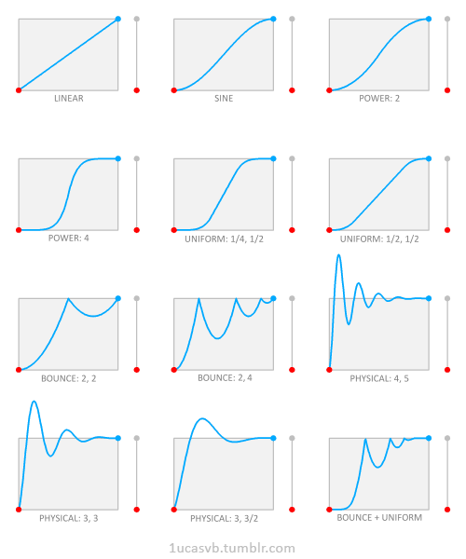
Index
What is it and Why is it important?
What is a Spline?
Spline Usability
Easing Functions
Splines Types
Introduction to the code
Todo’s
Homework
References

Slide 3
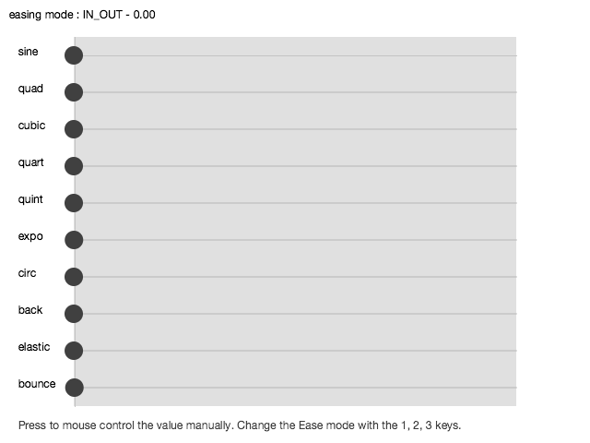
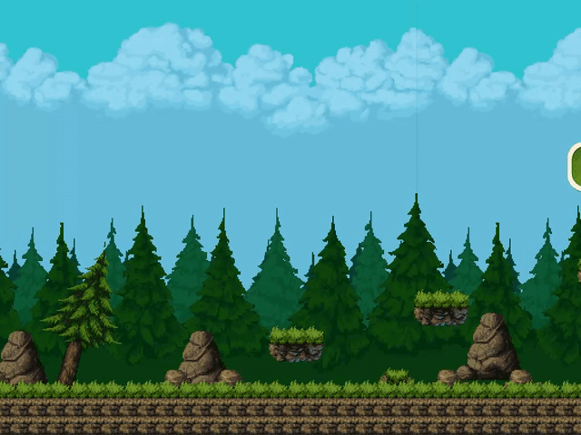
What is it and Why is it important?

Slide 4
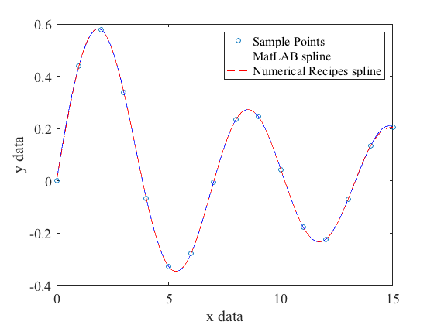
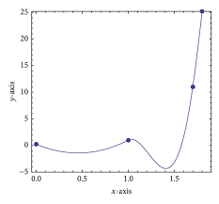
2. What is a Spline?

Slide 5
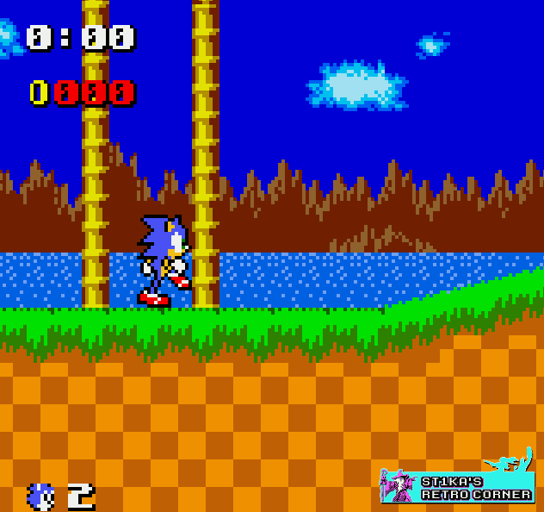
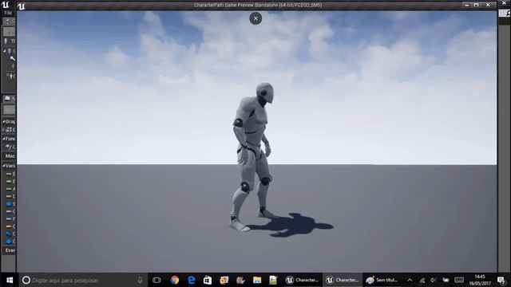
3. Spline Usability

Slide 6
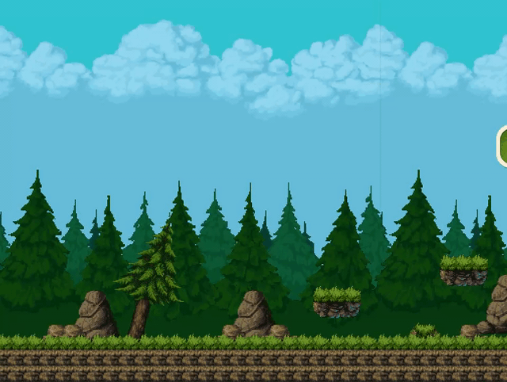
4. Easing Functions
Initial Value
Final Value
Duration
Total Elapsed Time

Slide 7
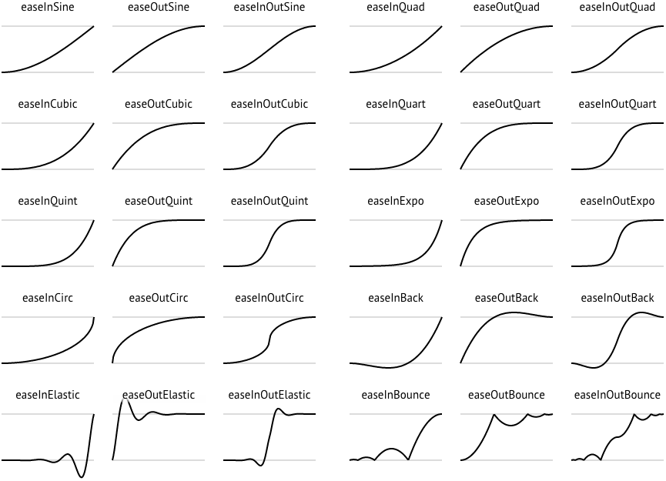
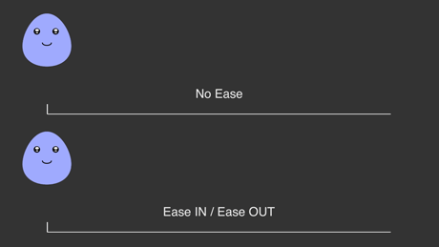
5. Splines Types

Slide 8
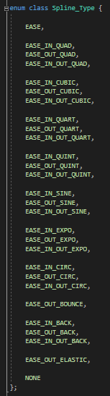
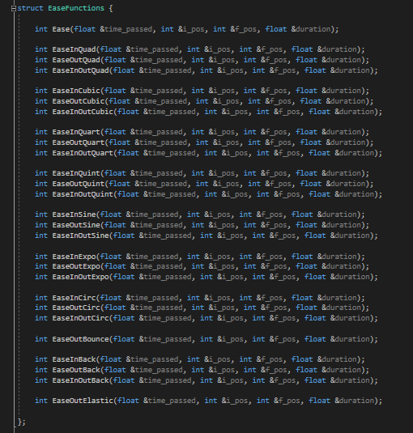
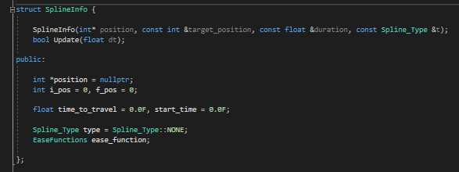
6. Introduction to the code

Slide 9
7. Todo’s
TODO 1
We want to delete spline when it's over. For this we have to:
Check the easing_splines list and removes those that Update return false. This means that Spline has finished.

Slide 10
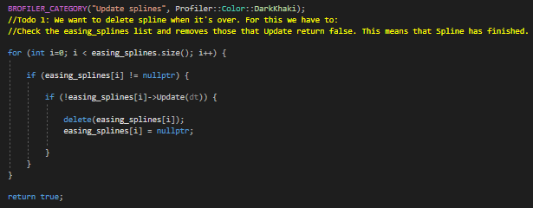
7. Todo’s
TODO 1: Solution

Slide 11
7. Todo’s
TODO 2
Calculate time since spline start and save the value in FLOAT

Slide 12
7. Todo’s
TODO 2: Solution

Slide 13
7. Todo’s
TODO 3
Check if the spline has finished using time_passed, to Update end we need to return false, look Todo 1

Slide 14
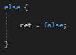
7. Todo’s
TODO 3: Solution

Slide 15
7. Todo’s
TODO 4
Make a switch for every case of spline and call its function, save the position (select three of one group to do the proof)

Slide 16
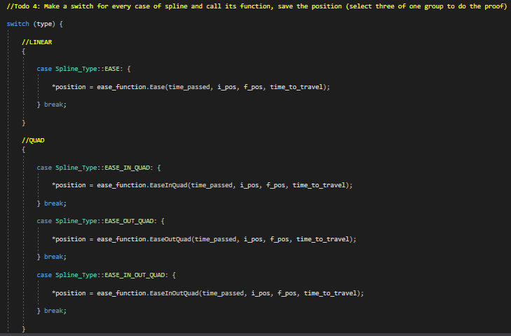
7. Todo’s
TODO 4: Solution

Slide 17
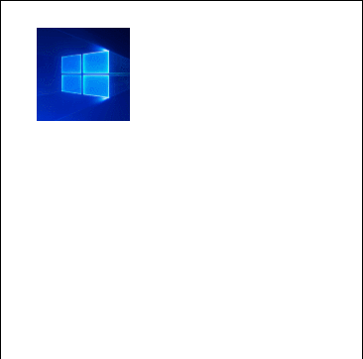
8. Homework
Adapt code to can work with X axis and Y axis simultaneously
Adapt code to can work with the scale

Slide 18
9. References
Easing https://github.com/Michaelangel007/easing/
Visual Easing Equations by Robert Penner http://www.gizma.com/easing/#quint1
Creating Usability WIth motion the ux in motion manifesto https://medium.com/ux-in-motion/creating-usability-with-motion-the-ux-in-motion-manifesto-a87a4584ddc
Motion UI IMB Design Lenguage https://www.ibm.com/design/language/motion-ui/basics/
Animating with Robert Penner's Easing Functions https://www.kirupa.com/html5/animating_with_easing_functions_in_javascript.htm
AHEasing Warrenm https://github.com/warrenm/AHEasing

